Slide 1
Part 1. What’s wrong with capitalism. Why we can’t reform it. Why we need socialism.
An introduction to socialism

Slide 2
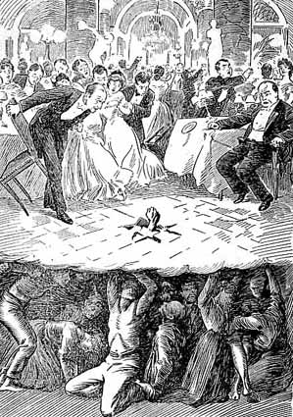
What is capitalism?
Society’s means of production privately owned.
System driven by hunt for profit.
Source of wealth is the labor of working people.
‘From the depths’ (USA, 1907)

Slide 3
An unjust, oppressive system
Exploitation.
Racism.
Xenophobia.
Sexism.
Homophobia.

Slide 4
Imperialism & war
Imperialism — most highly developed form of capitalism.
Seeks to dominate whole world.
Permanent war drive and militarism.

Slide 5
Global warming
Most serious threat facing humanity.
Caused by capitalism’s insatiable thirst for profit.

