Slide 1
PART 2. How social change takes place. Building the struggle today. Building the mass socialist party.
An introduction to socialism

Slide 2
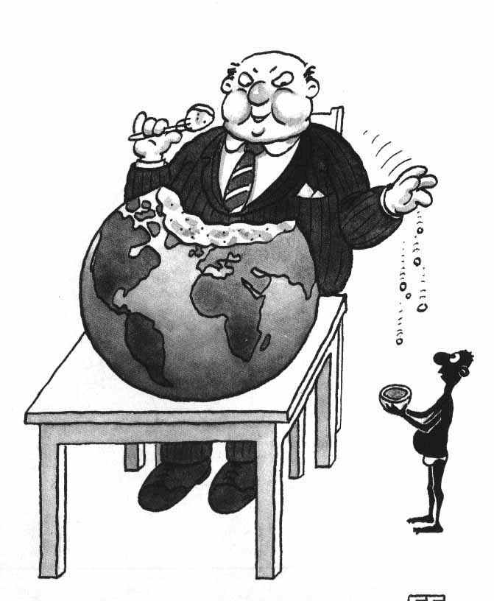
Change the system
People’s needs vs corporate profits.
Working people must run society.
Put economy under social control.
Start transition toward socialism.

Slide 3
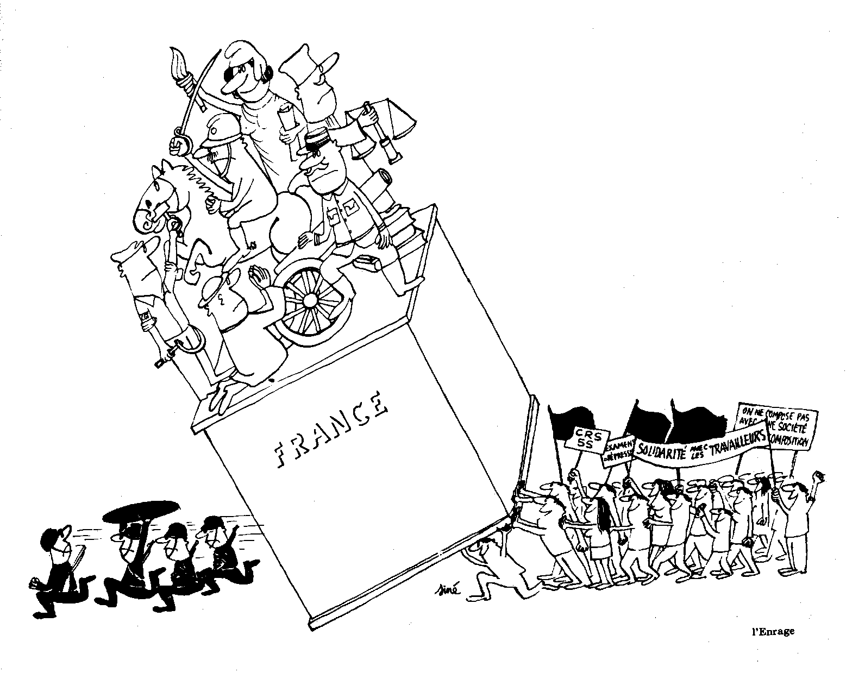
How can fundamental social change take place?
No recipes; many variants possible.
Crises inherent in system; people’s thinking shaken up.
Lenin: When ruling class can’t go on in old way & masses won’t go on in old way.
France, May-June 1968.

Slide 4
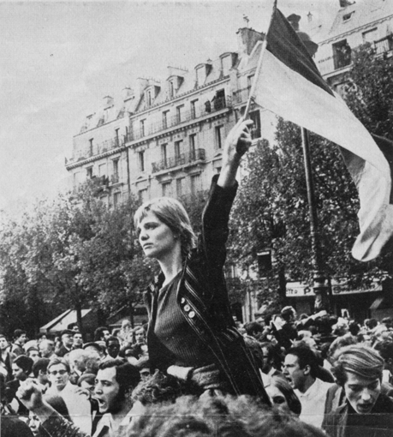
How can the people win?
Mass action, unity & organisation.
Workers need own political party.
Trotsky’s analogy: piston & steam.
France May-June 1968.

Slide 5
Socialist party must be built now!
Long, complicated process.
Can’t wait for ‘big bang’.
Build with what we have, right now, and see what happens.

Slide 6
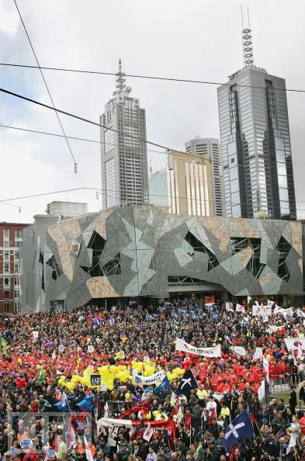
How we struggle today
Building campaigns is crucial.
Campaigns mean united front work.
People learn in struggle.
Socialists must be there.
November 15, 2005 IR protest, Melbourne.

Slide 7
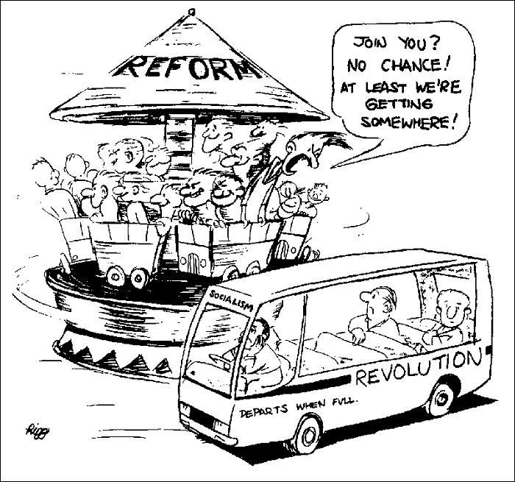
Reforms vs. reformism
We are always fighting for reforms.
Vital to give people confidence, sense of power.
Reformism: idea that system can be changed bit by bit.
Reformism: a fatal mistake.

Slide 8
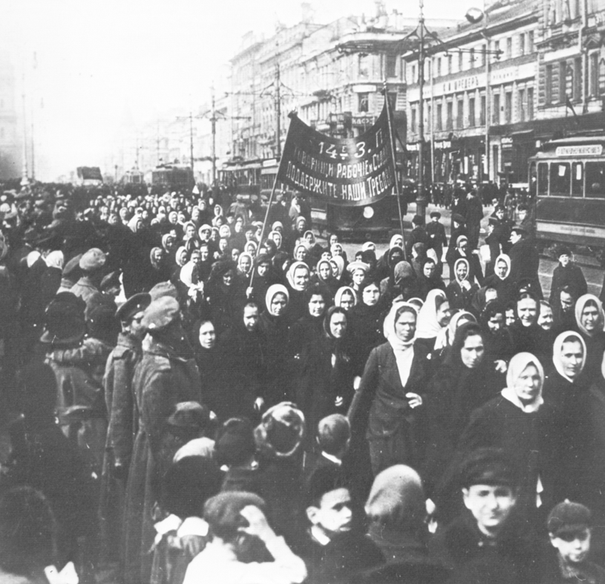
Our transitional method
Need to link present struggles and socialist goal.
Start from where people are at and go forward from there.
Experience of struggle can radicalise people.
Women demonstrate, Petrograd, March 1917.

Slide 9
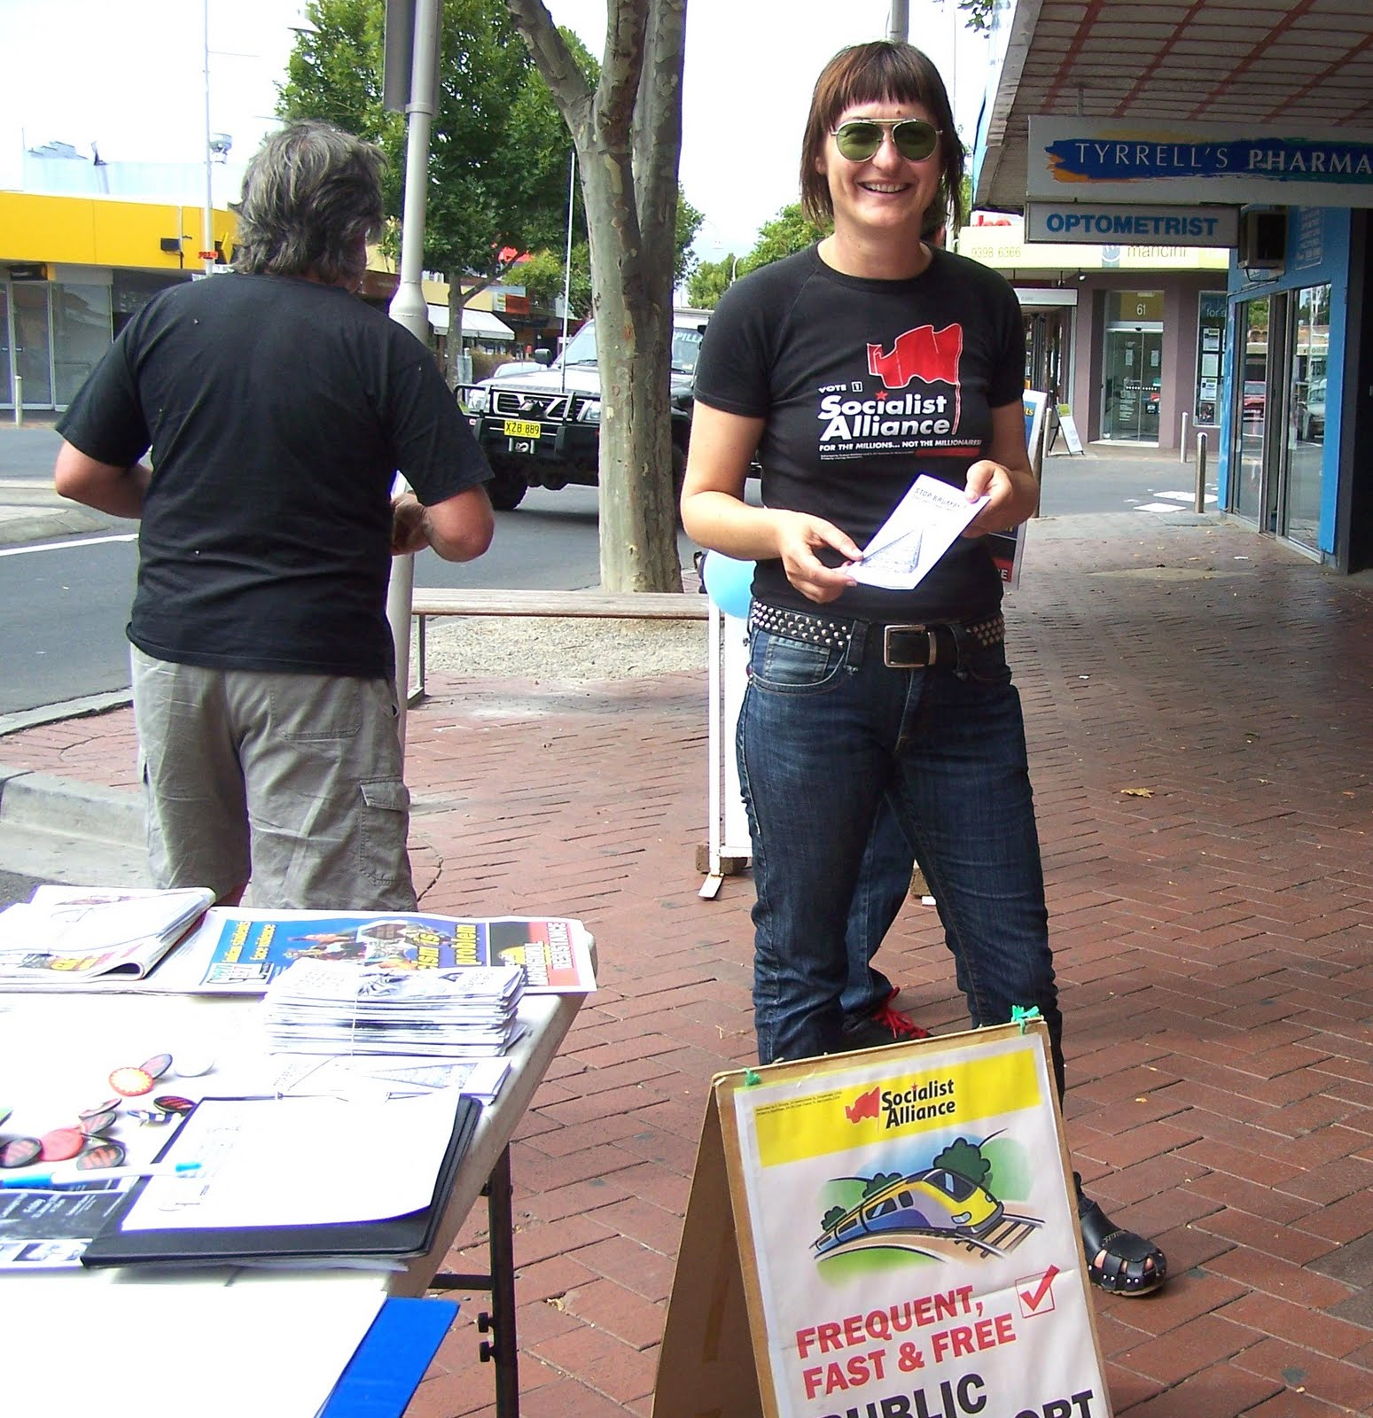
Running in elections
Participating in elections is very important.
Make propaganda, measure strength.
But we are not electoralists; mass struggle is decisive.
Altona by-election, February 2010.

Slide 10
Struggle for unity of left & progressive forces
We must show leadership in struggle.
We must always strive to unite left and progressive forces.
Unite in struggle; don’t erect unnecessary barriers.

