Slide 1
PEOPLE & PLANET BEFORE PROFIT: An introduction to socialism and the

Slide 2
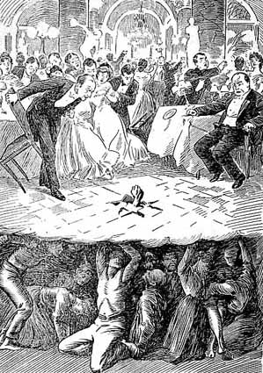
What is capitalism?
Society’s means of production privately owned.
System driven by hunt for profit.
Source of wealth is the labor of working people.
‘From the depths’ (USA, 1907)

Slide 3
How Capitalism produces class divisions.
Capitalist class.
Working class.
Middle classes.

Slide 4
An unjust, oppressive system
Sexism
Racism
Homophobia
War
Poverty & exploitation
Global warming
Environmental destruction

Slide 5
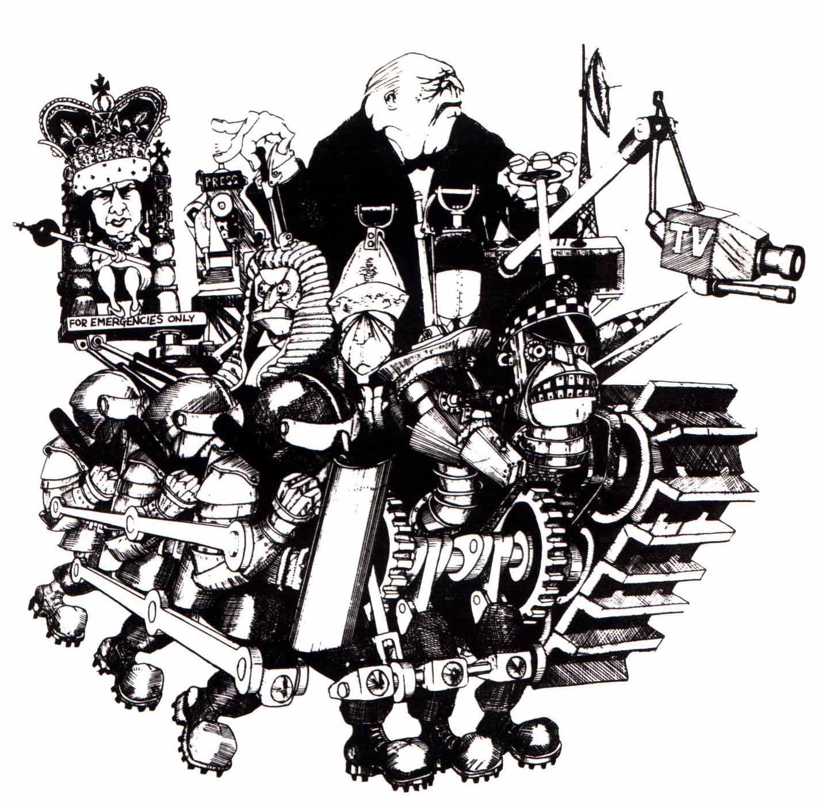
What is the State?
Ultimate guardian of class rule.
Fosters ideology and force and repression of the working class
What is the alternative?

Slide 6
Can capitalism be reformed?
As long as the system remains, all gains can only be provisional.
Individual solutions may sound attractive and effective, but our lifestyle ‘choices’ are limited as long as the system remains in place…
Short answer….
NO!

Slide 7
What is Socialism?
Economy brought under social ownership and control.
Basis for profound social change.

Slide 8
But how do we get there?
No map or blueprint, but have to fight for it and that fight must involve the majority of people.
Ruling class will fight to defend their privilege and wealth.
Capitalist crisis and working class resistance - struggles emerge continuously throughout history
Working class/majority need to organise to win/defend our interests - that's why we need a party of our own.

Slide 9
A party for the 99%
Connected with the struggles of the day
Raising the profile of socialist ideas
Learn from past victories…and defeats
A party that seeks to change the system.

Slide 10
The Socialist Alliance
Socialist Alliance is a political organization to help build a socialist future through the self-emancipation of the working class
An activist organization - different levels but all encouraged to put in as much - but developing activists for now and the future and organizing them to help build social movements.
Open to new regroupments and alliances, practicing solidarity-based internationalism
Committed to developing a serious but non-dogmatic political theory and policy

Slide 11
Green Left builds the movements and lets people know about them around the country and internationally
It counters the lies from the mainstream press and proudly takes the side of workers and the oppressed.
GL builds support for our ideas and our party’s work.
Selling and writing builds up confidence of members to talk politics and stand up for our ideas.

Slide 12
Fight for socialism
Let the ruling classes tremble at a Communistic revolution. The workers have nothing to lose but their chains. They have a world to win. ( Karl Marx) Before a revolution happens, it is perceived as impossible; after it happens, it is seen as having been inevitable” (Rosa Luxemburg)

